Slide 1

Austin Traffic Incidents Visualizing Austin Road Use
awheel Intelligence:
Jason Bartling
Ian Kelly
Brandon Rose

Slide 2

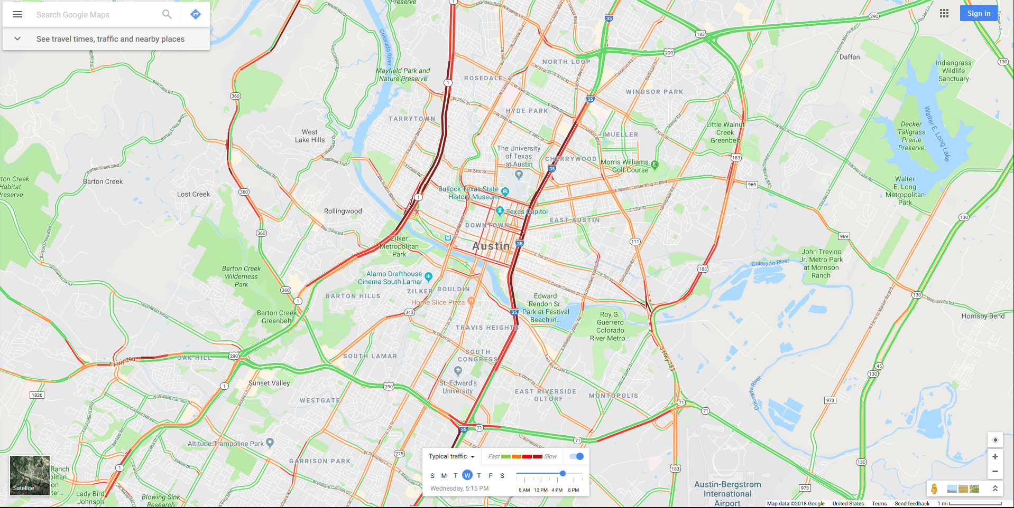
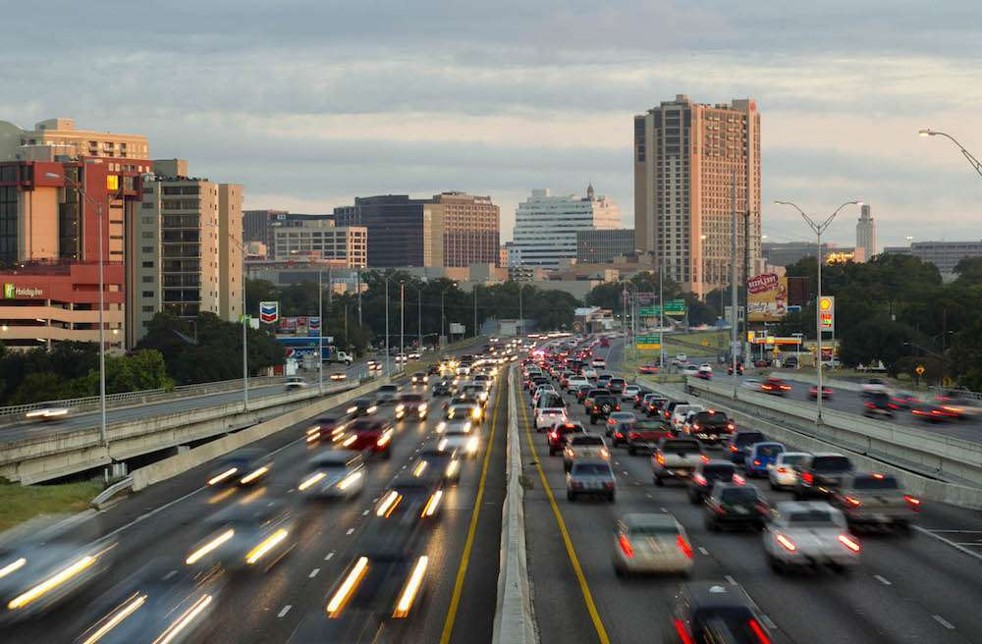
Introduction
Austin growth: 16,890 new residents (out-of-state) [Texas Association of Realtors 2015]
Methods of Traffic Analysis: travel demand modeling and average daily traffic [Bakiera 2016]
https://www.google.com/maps
https://www.equipmentworld.com/txdot-moving-forward-with-i-35-improvements-in-austin-via-mobility35-program/

Slide 3
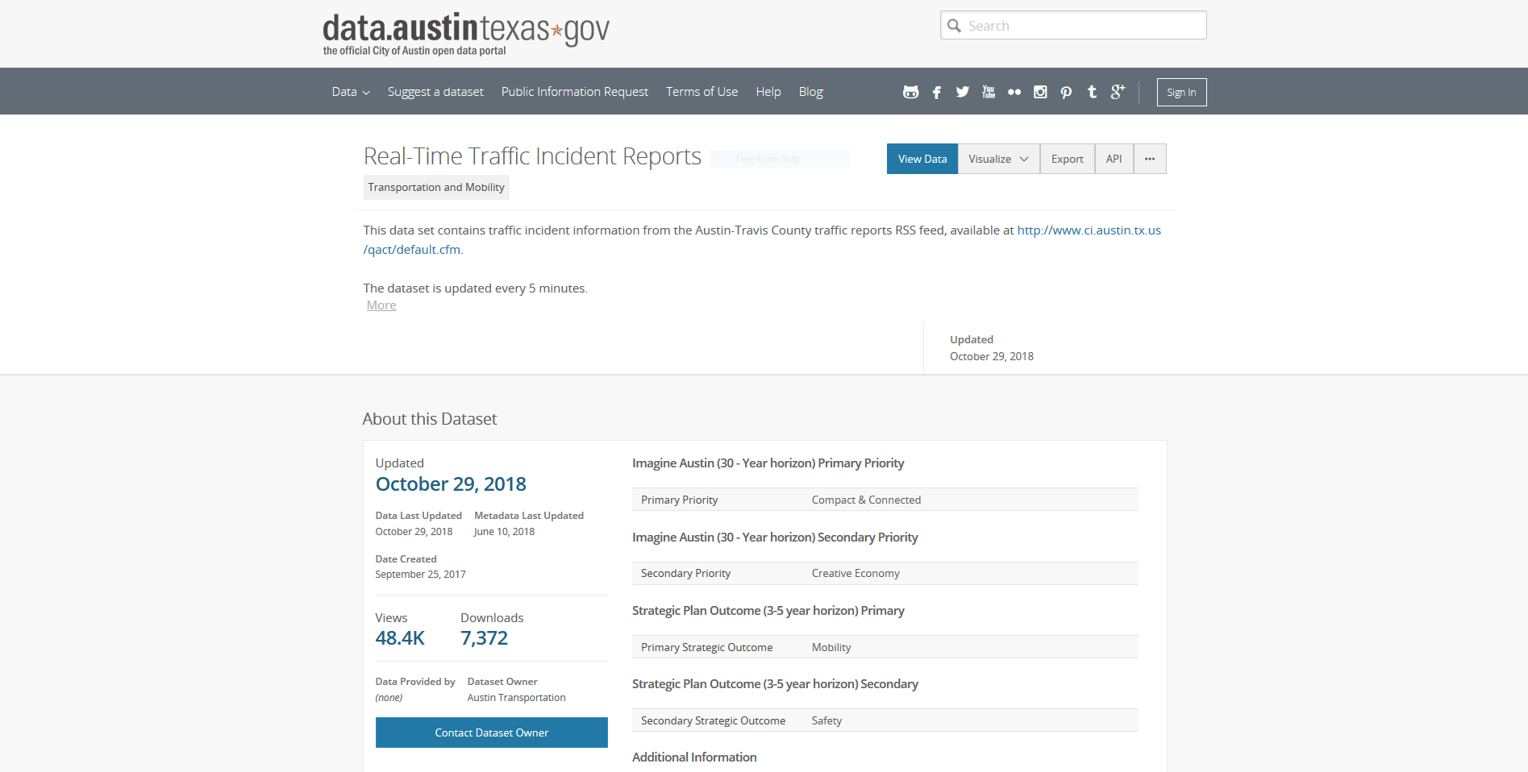

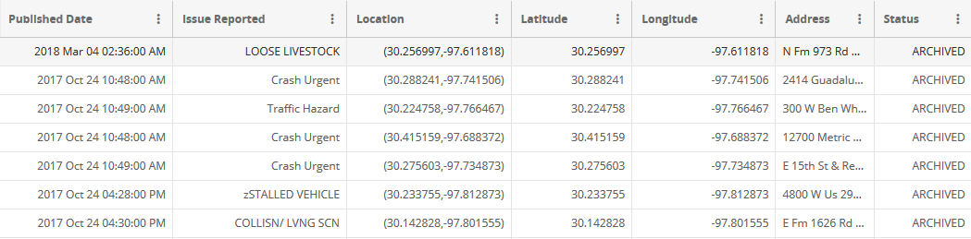
City of Austin, Open Data Portal
Table 1: Sample Incident Data Fields
https://data.austintexas.gov/Transportation-and-Mobility/Real-Time-Traffic-Incident-Reports/dx9v-zd7x

Slide 4
Incident types by class
Table 2: Classes
Crash | Hazard | Advisory
AUTO/ PED | Traffic Hazard | BLOCKED DRIV/ HWY
BOAT ACCIDENT | Traffic Impediment | LOOSE LIVESTOCK
COLLISION | TRFC HAZD/ DEBRIS | N / HZRD TRFC VIOL
COLLISION/PRIVATE PROPERTY | HIGH WATER | VEHICLE FIRE
COLLISION WITH INJURY | ICY ROADWAY | zSTALLED VEHICLE
COLLISN / FTSRA
COLLISN/ LVNG SCN
Crash Service
Crash Urgent
FLEET ACC/ INJURY
TRAFFIC FATALITY
https://data.austintexas.gov/Transportation-and-Mobility/Real-Time-Traffic-Incident-Reports/dx9v-zd7x

Slide 5
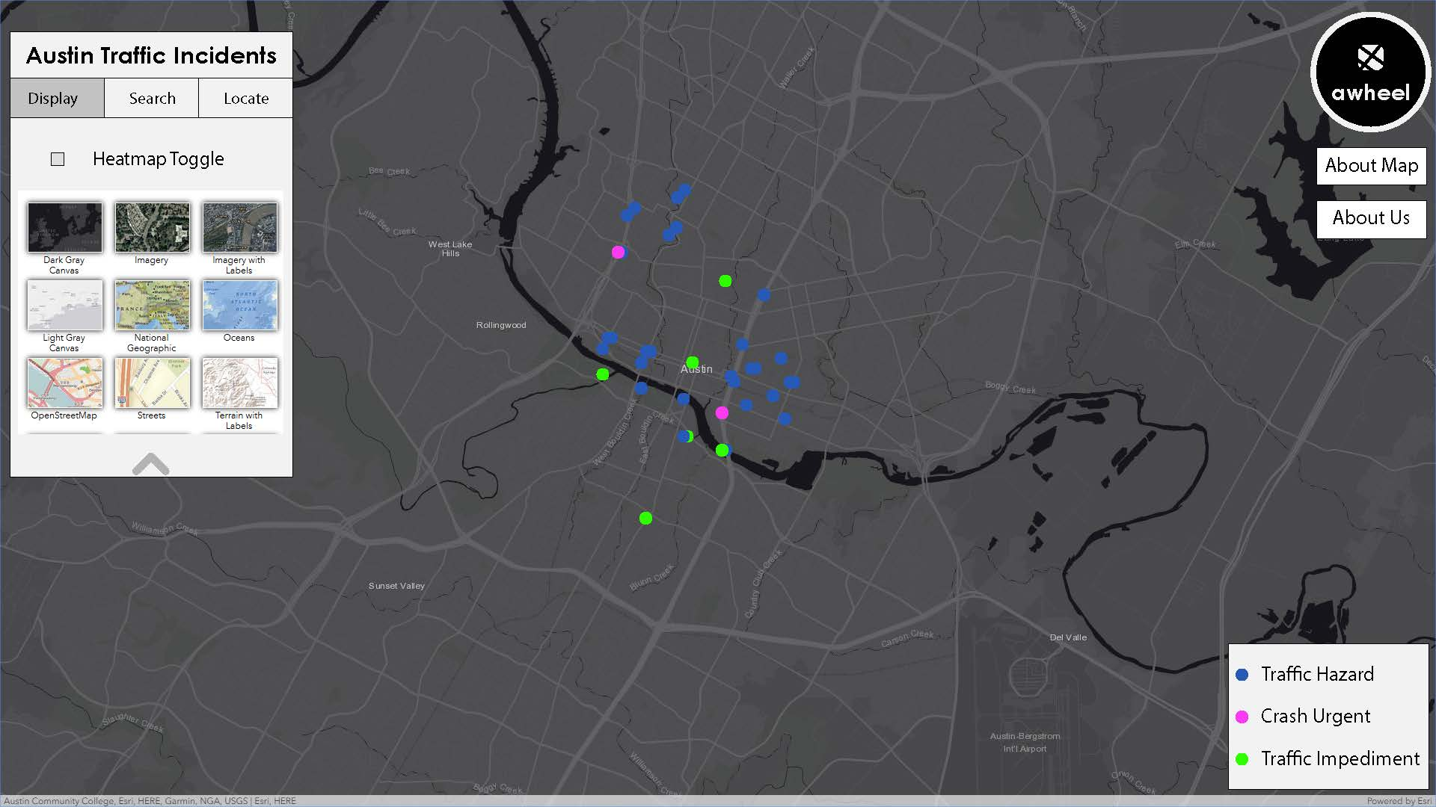
Prototype Interface
Figure 1: Proposed User Interface

Slide 6
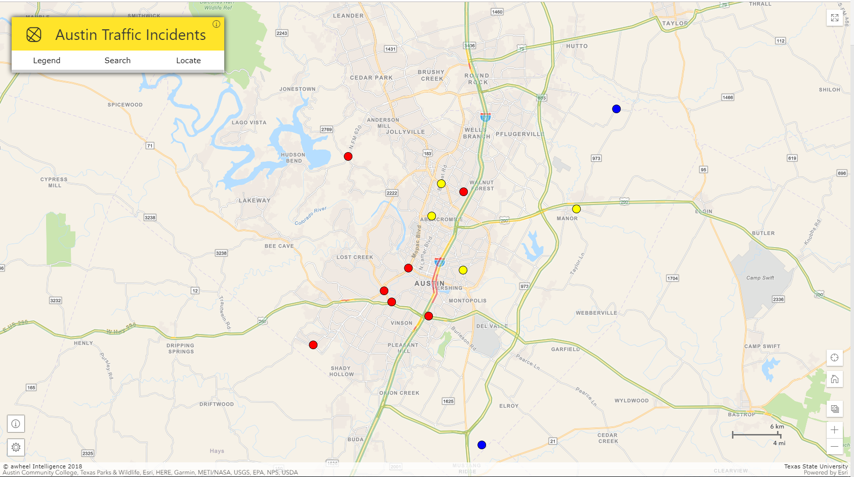
Final interface
Figure 2: Final User Interface

Slide 7
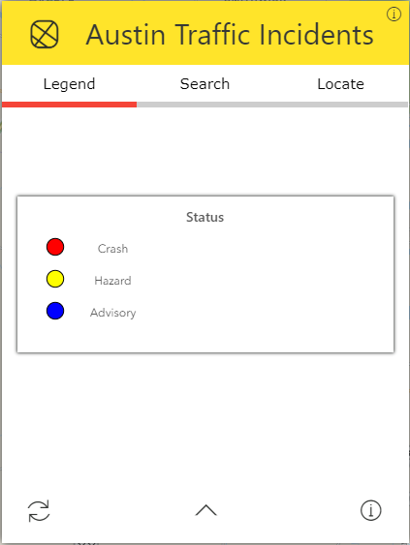
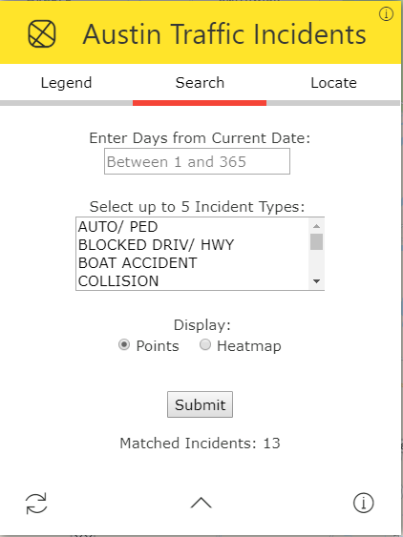
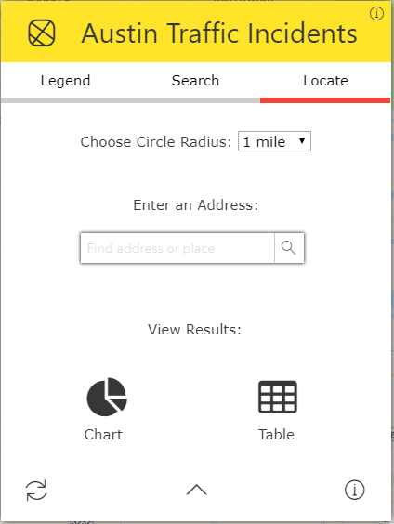
Toolbox
Figure 3: Legend tool
Figure 4: Search tool
Figure 5: Locate tool

Slide 8
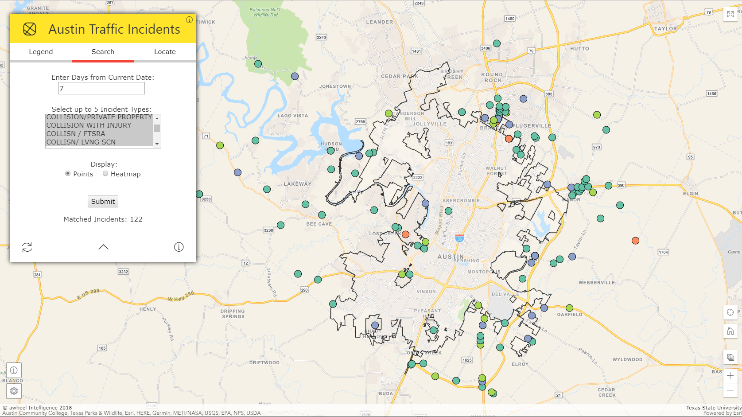
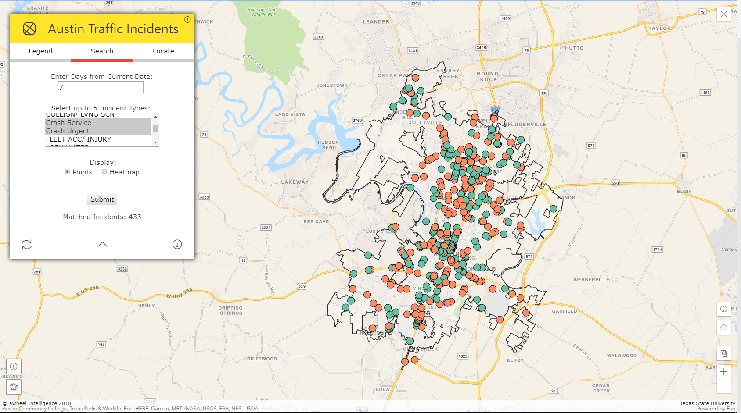
Spatial patterns
Crash
…
COLLISION
COLLISION/PRIVATE PROPERTY
COLLISION WITH INJURY
COLLISN / FTSRA
COLLISN/ LVNG SCN
Crash Service
Crash Urgent
…
Figure 6: Collision incident types outside city limits – last 7 days
Figure 7: Crash incident types within city limits - last 7 days

Slide 9



DATA AND METHODOLOGY
Identified City of Austin Open Data Portal as source
Real-Time Traffic Incident Reports
Socrata Open Data API for creation of near-real-time web map
Format: JavaScript Object Notation (JSON)
Map functionalities and foundation: ArcGIS JavaScript API
Specific functionalities
Search by up to 5 incident types and date range from today
Geocode address to display nearby traffic incidents
Heat map using historic data to show greatest concentration of traffic incidents
Chart and Table to visualize nearby traffic incidents

Slide 10






3rd party Libraries
Font Awesome Icons
W3 Schools CSS
Tippy JS for Tooltips
Chart JS for Doughnut Chart
jQuery to Control User Input
HERE WeGo for Live traffic tiles

Slide 11
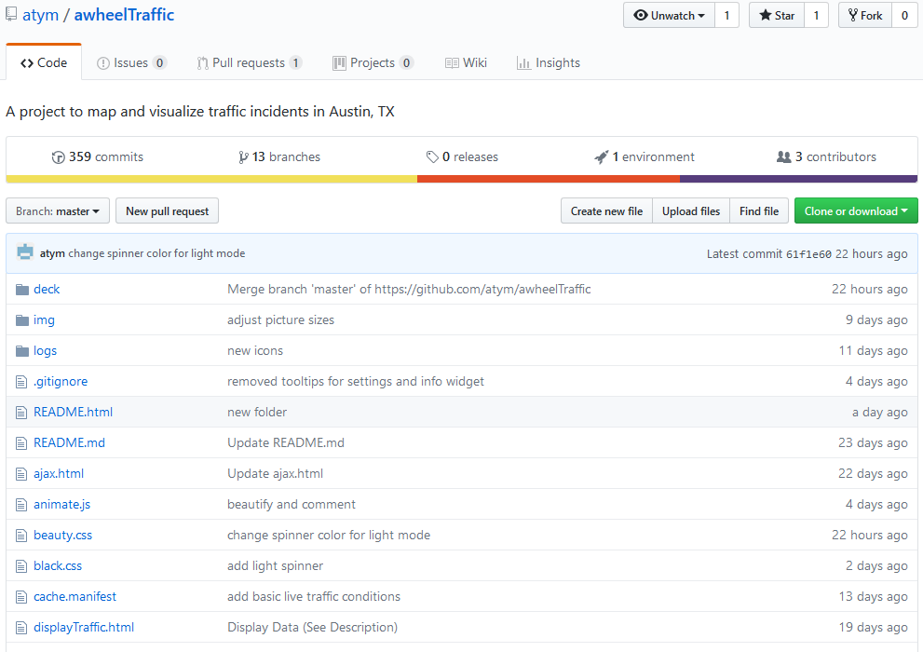
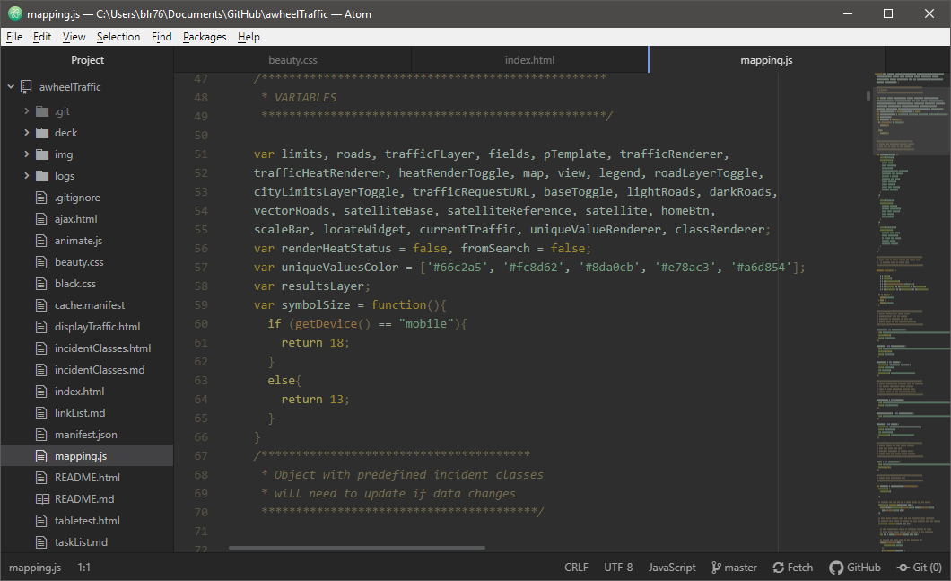
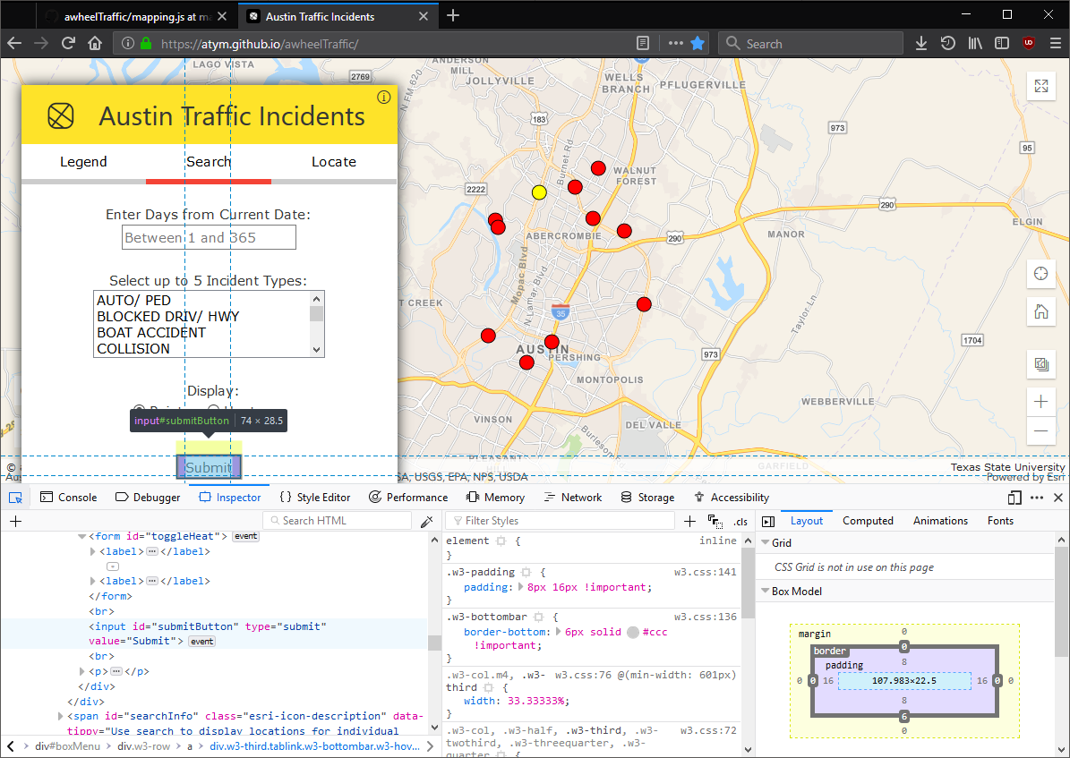



Development
Stats
Over 360 commits
400+ lines of HTML
80+ custom CSS rules
1,400+ lines of JavaScript

Slide 12
Demo

Slide 13

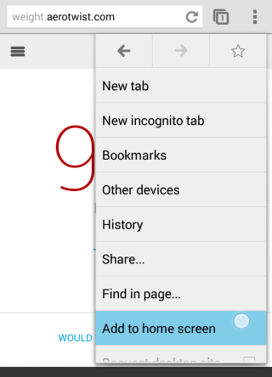
Mobile Web app
atym.github.io/awheelTraffic
iOS
Android

Slide 14
Conclusion
Final deliverable: Interactive map of traffic incidents that can be limited by date or spatial query
Initial display: Active incidents classified into 3 categories: crash, hazard, advisory
Motivation: Educate travelers in Austin to most dangerous roads previously unknown
Outcome: Data presentation optimized for mobile users
Future work: Implement route navigation from one address to another
Identify route danger

Slide 15
References
Bakiera, A., R. Weaver, C. Hiner, and Y. Lu. 2016. Spatial analysis of traffic congestion and transit accessibility in Austin, Texas. https://digital.library.txstate.edu/bitstream/handle/10877/6323/BAKIERA-THESIS-2016.pdf?sequence=1 (last accessed 29 October 2018).
Texas Relocation Report. 2017. Texas Association of Realtors. https://www.texasrealestate.com/wp-content/uploads/2017TexasRelocationReport.pdf (last accessed 29 October 2018).
Transportation and Mobility. https://data.austintexas.gov/Transportation-and-Mobility/Real-Time-Traffic-Incident-Reports/dx9v-zd7x (last accessed 1 November 2018).

Slide 16





Appendix
Jason Bartling:
Data load queries, Search tool, Locate tool
Loading spinner implementation, Map reset and zoom
Ian Kelly:
HTML, CSS, and animation JS
Chart, Table, and Live traffic layer
Brandon Rose:
Initial data display, Data visualization, Legend
Class, Heatmap, and Incident type renderers

